Slide 1
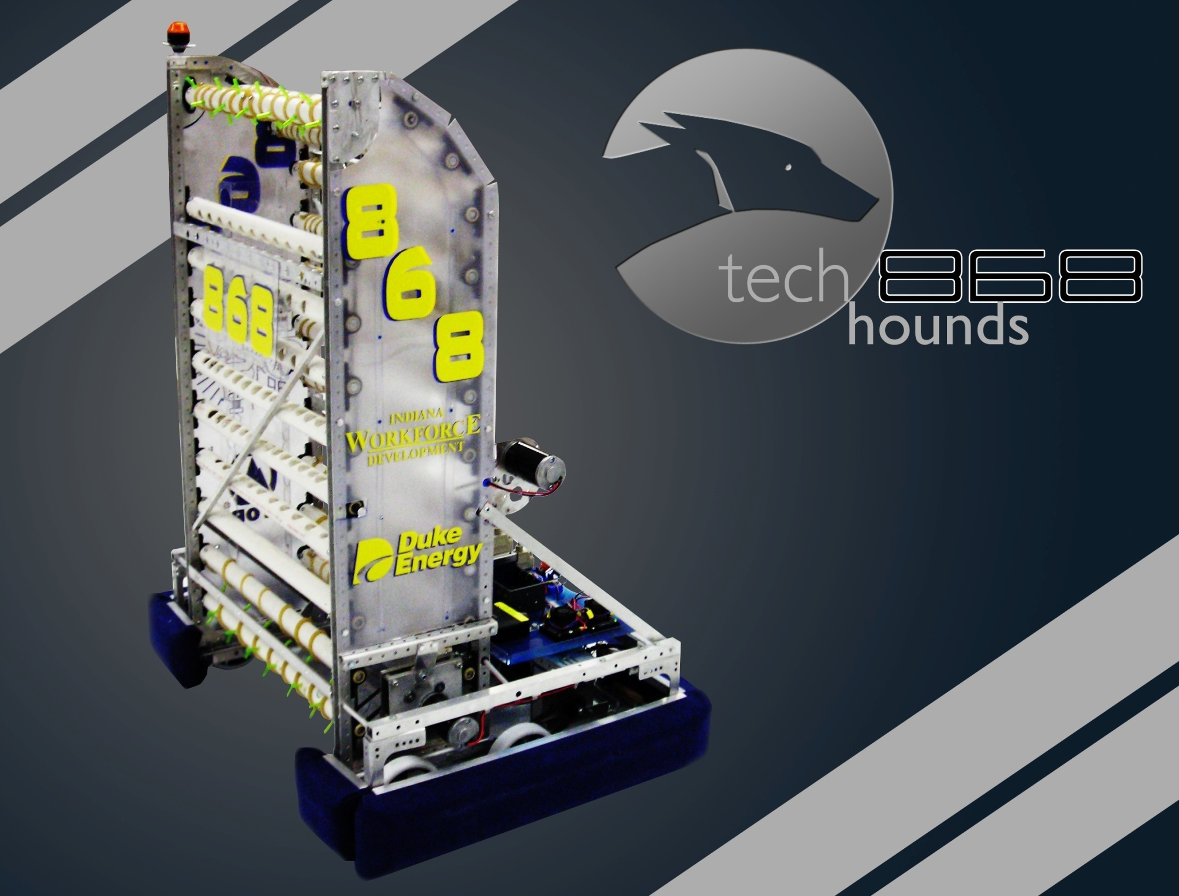

Robotics Team
Call-Out
September 4, 2014

Slide 2
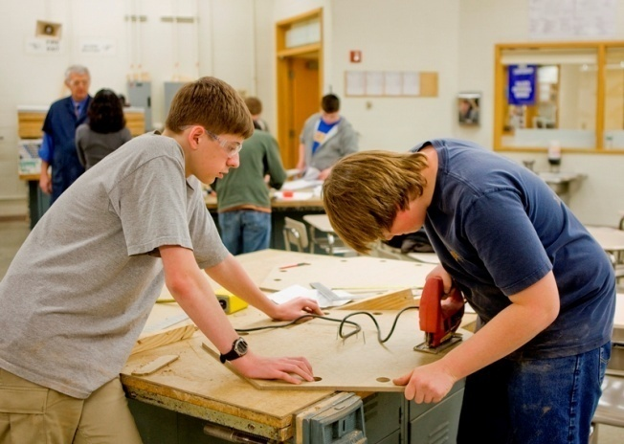
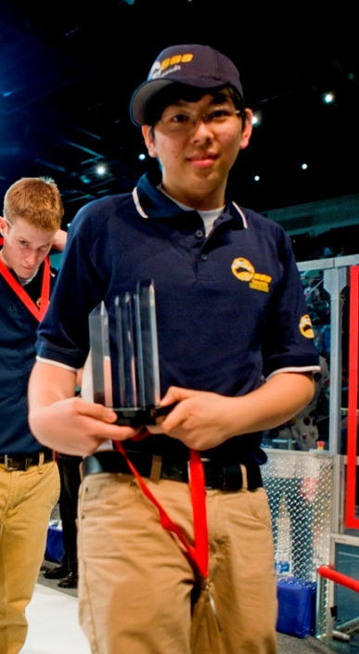
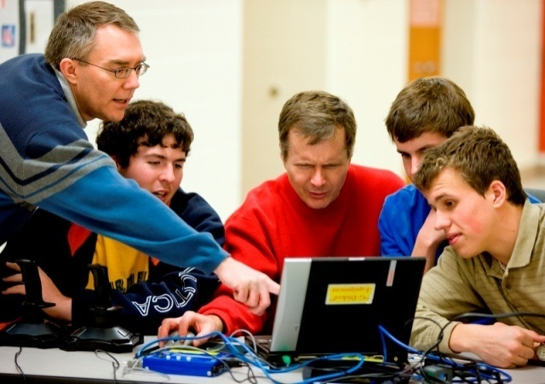
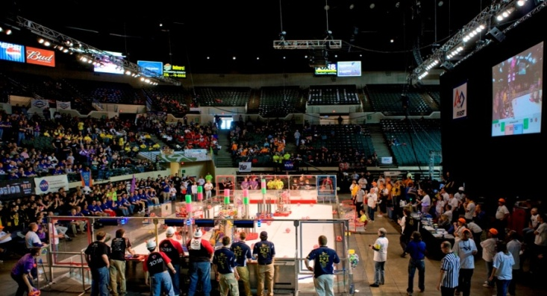
Teacher Leads Mr. John Coghlan
Mrs. Laura Erli
90 students
30+ teachers, mentors, and volunteers
13 years of experience
6 weeks
30+ meetings
130+ hours of work
Countless goals
Limitless opportunities

Slide 3
Build Season
Our Six-Week Journey

Slide 4
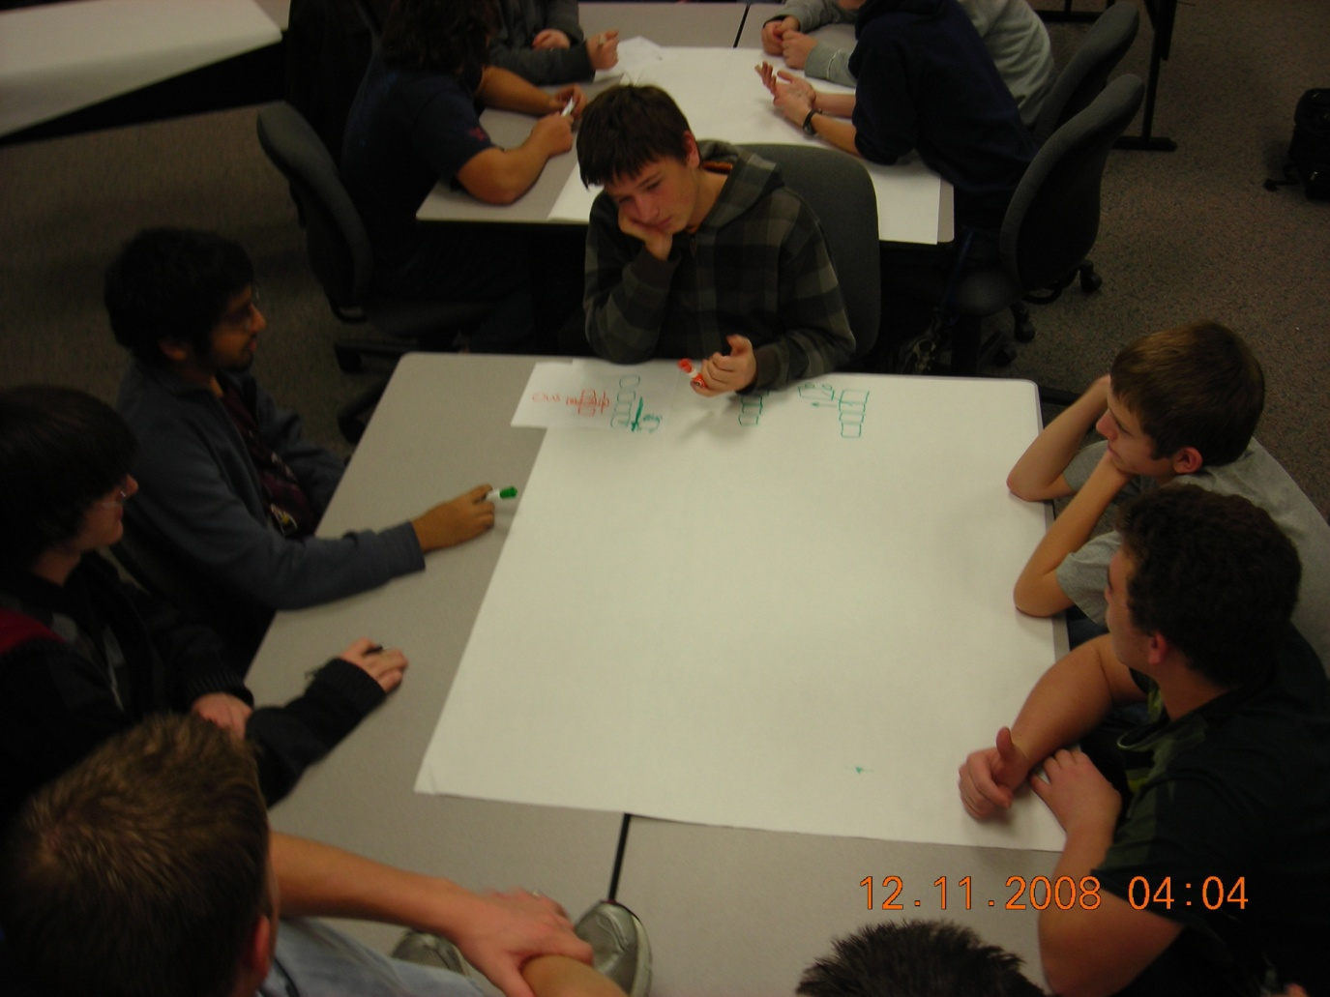
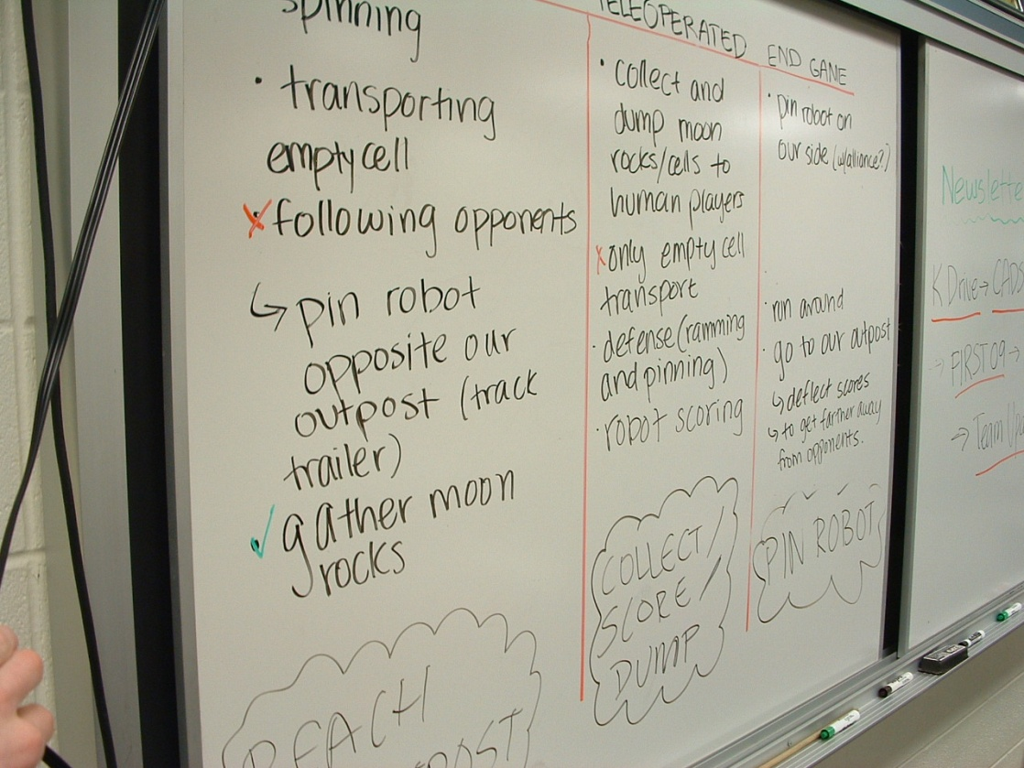
BRAINSTORMING AFTER KICKOFF

Slide 5
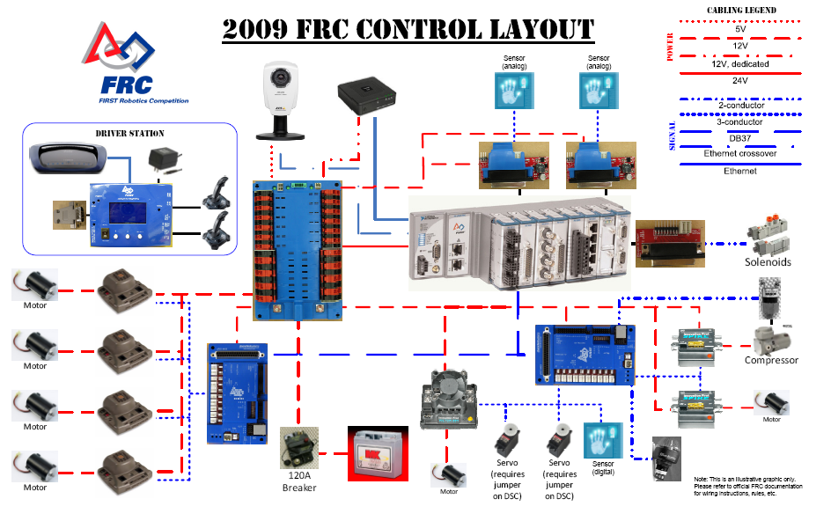
KIT OF PARTS

Slide 6
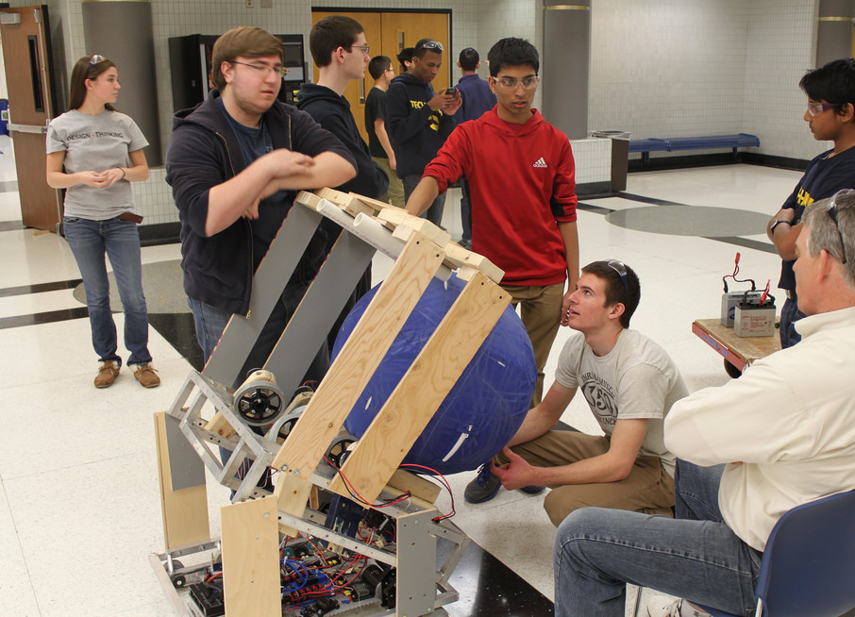
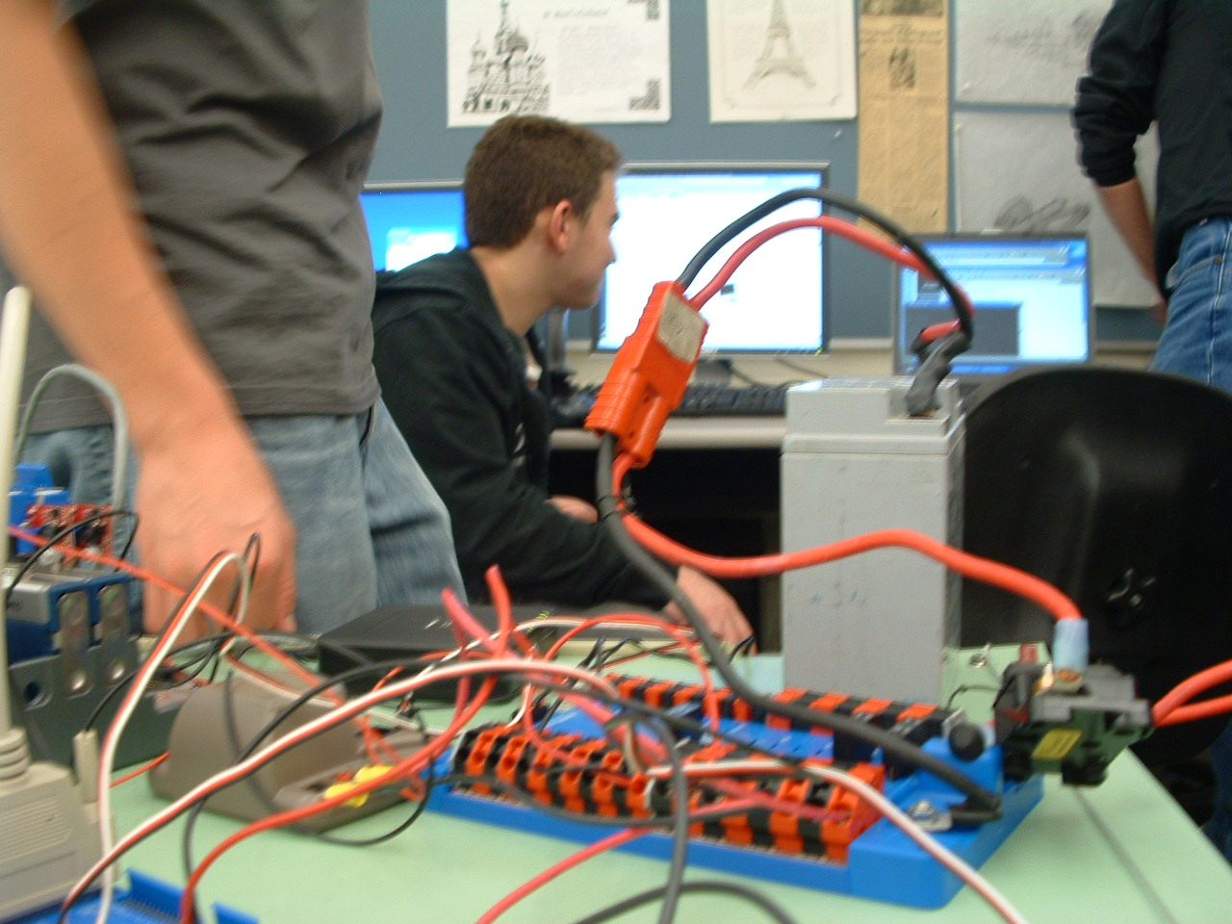
PROTOTYPING AND TESTING

Slide 7
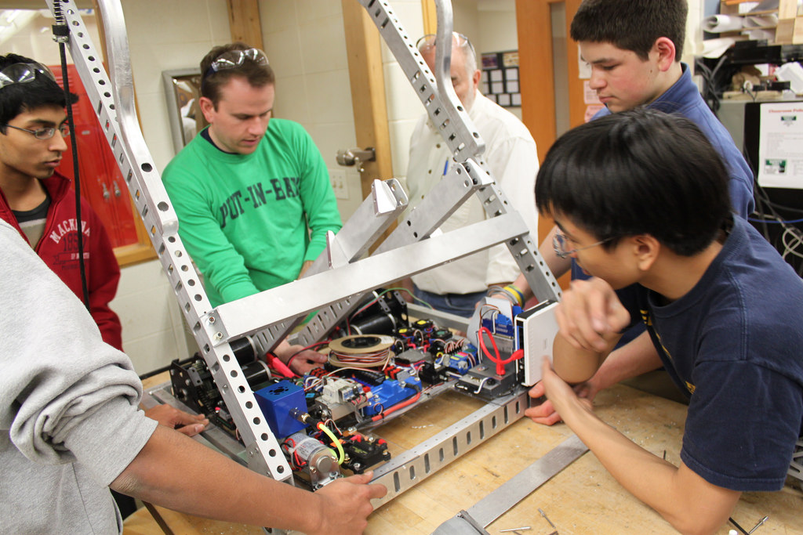
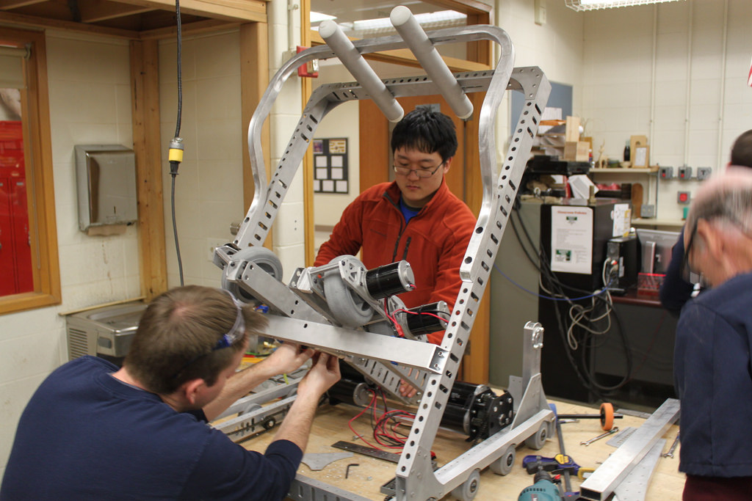
FINAL CONSTRUCTION

Slide 8
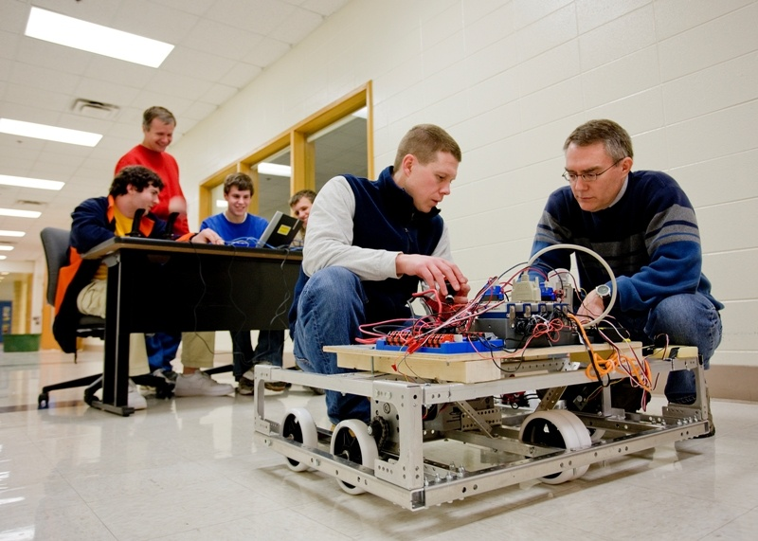
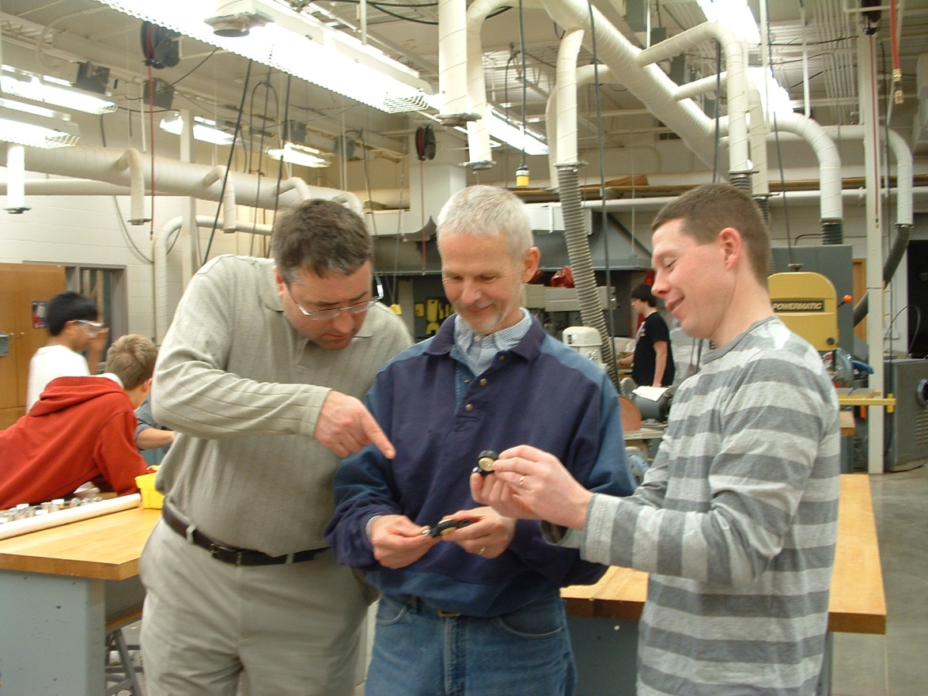
ENGINEERS AS MENTORS

Slide 9
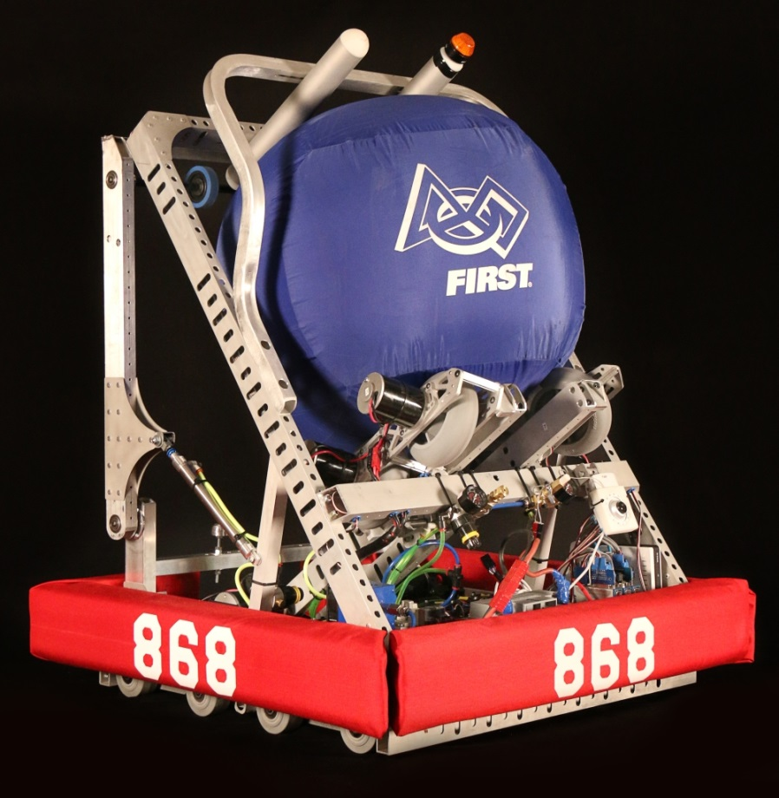
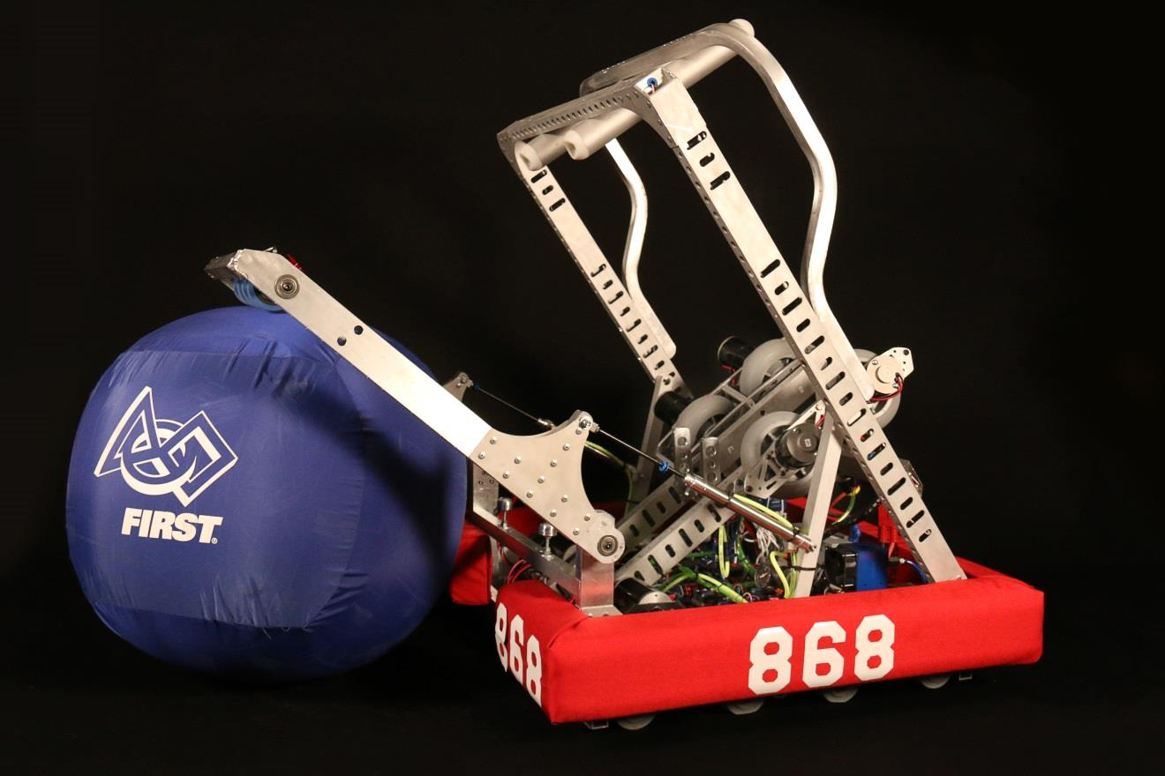
READY TO COMPETE

Slide 10
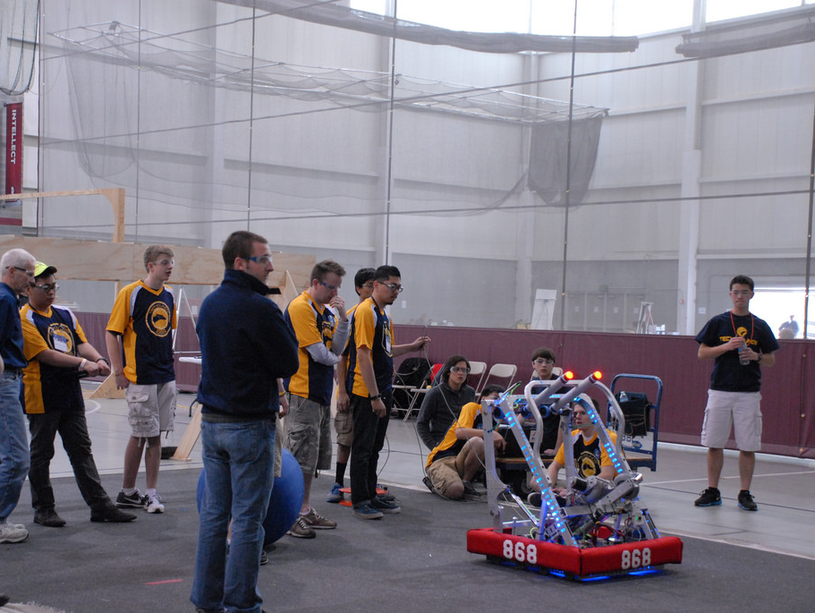
PRACTICING AT COMPETITON

Slide 11
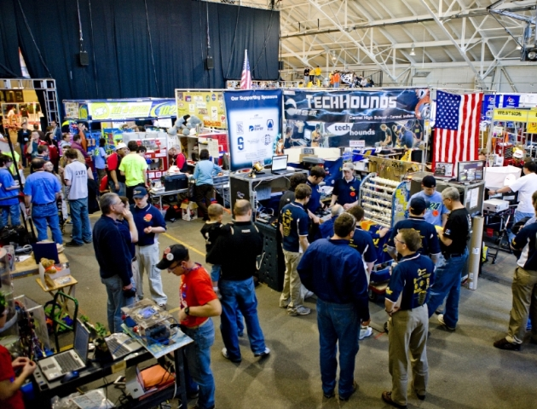
THE PIT AREA

Slide 12
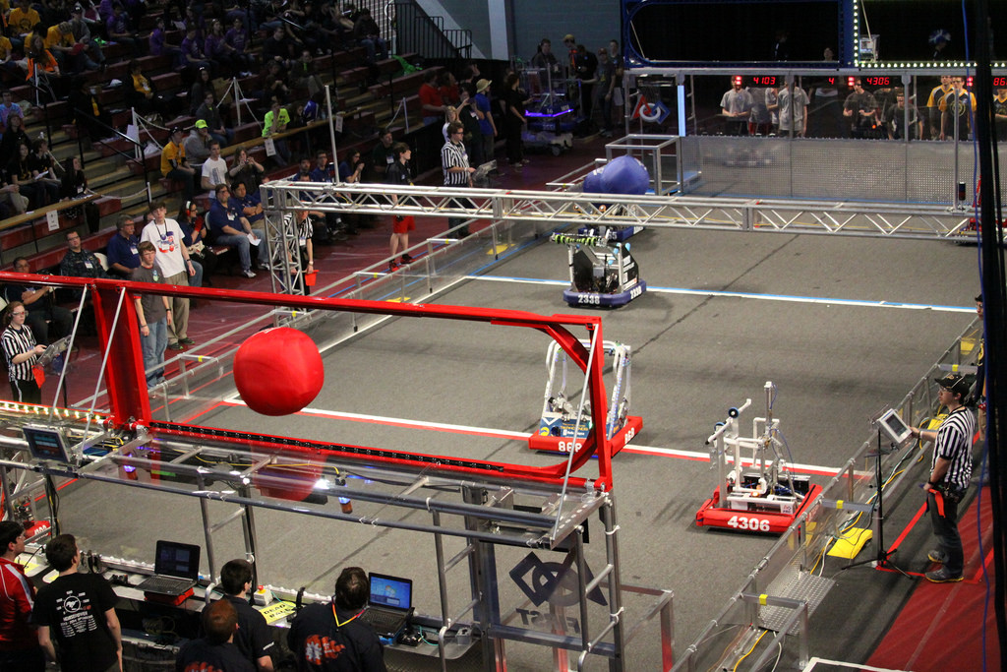
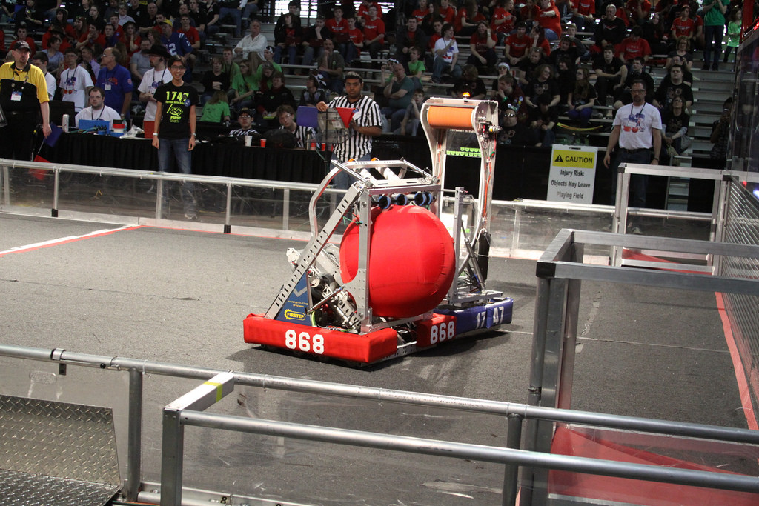
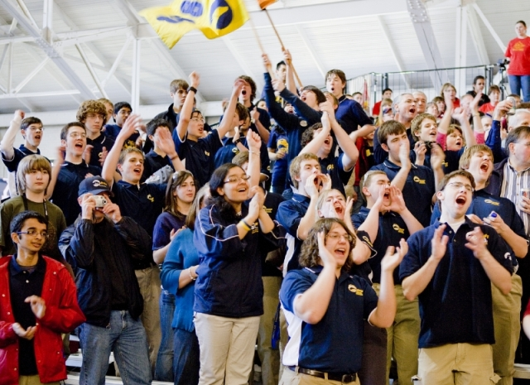
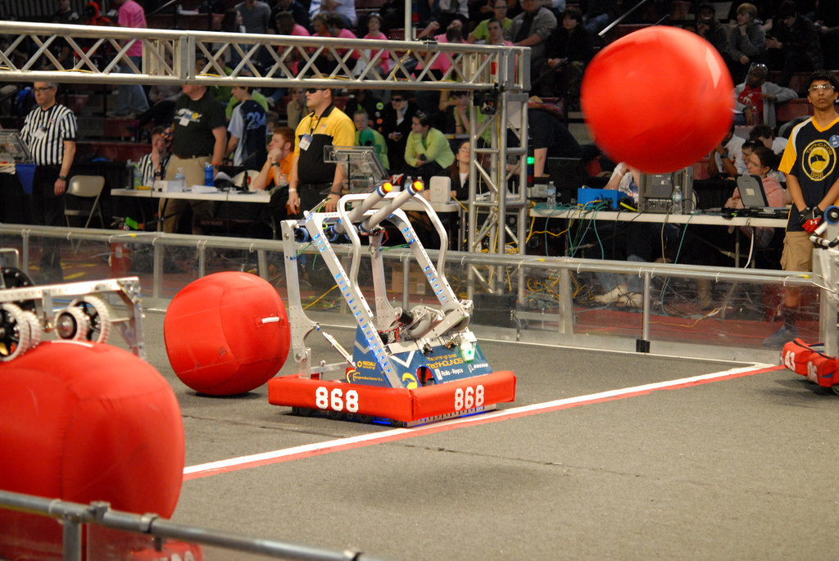

Slide 13
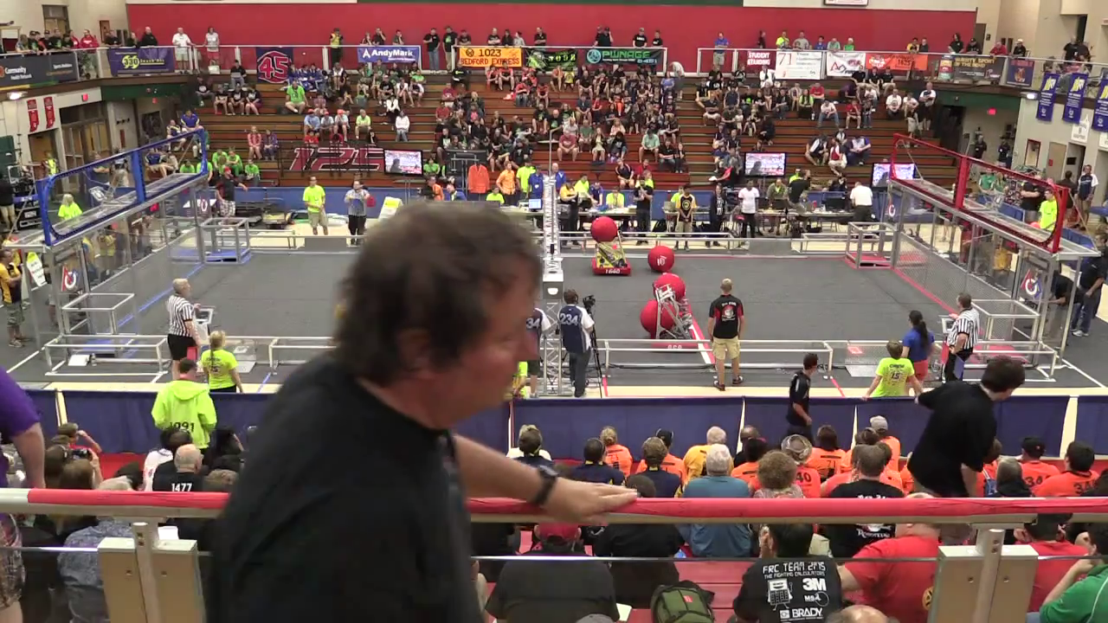
Competition

Slide 14
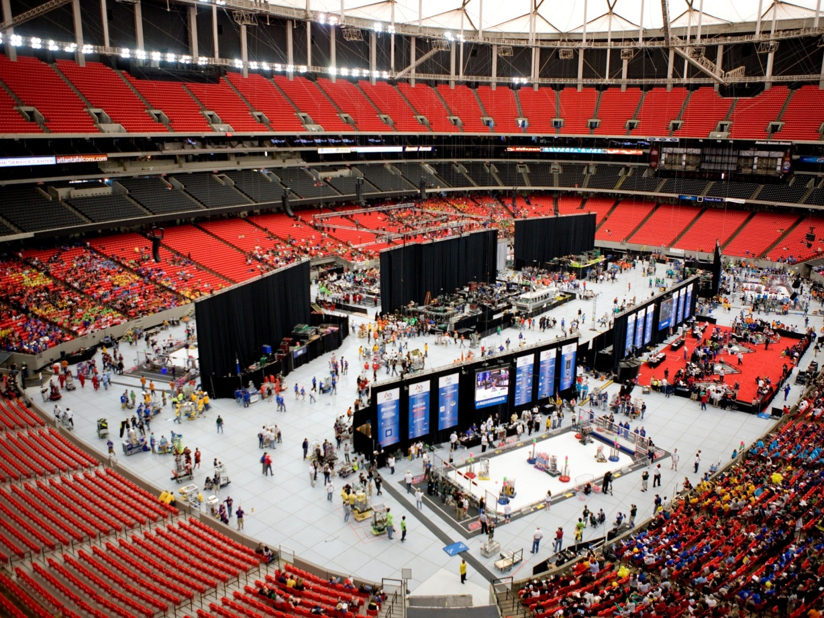
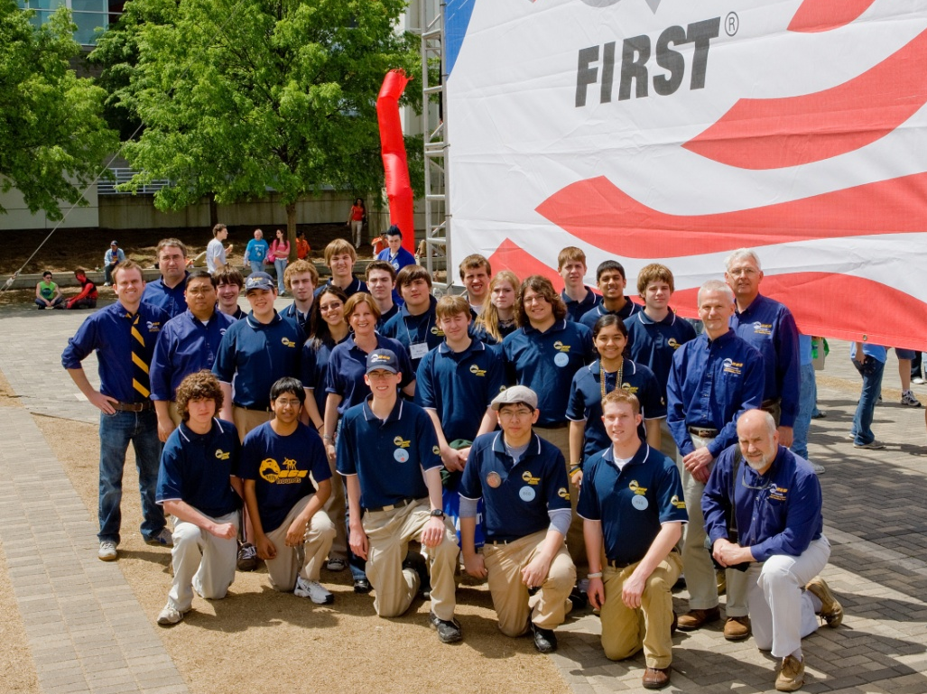
INTERNATIONAL COMPETITION

Slide 15
Team Management
Leaders: Jackson Otto and Zack Simpson

Slide 16
Robot Operations
Leader: Aryaman Gupta

Slide 17
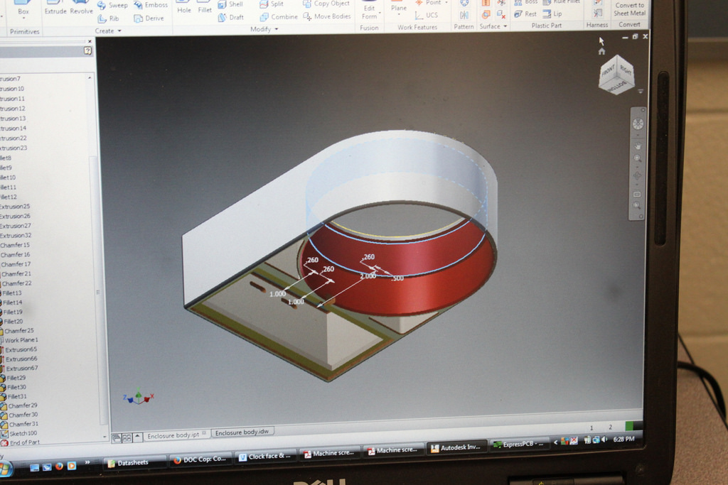
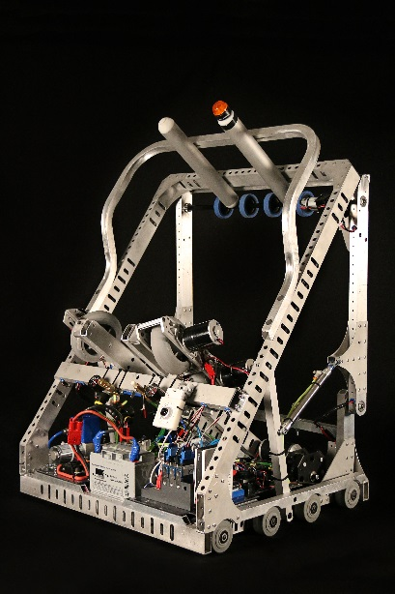
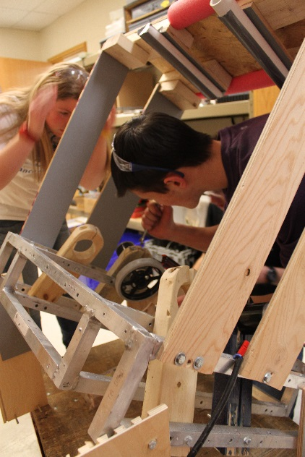
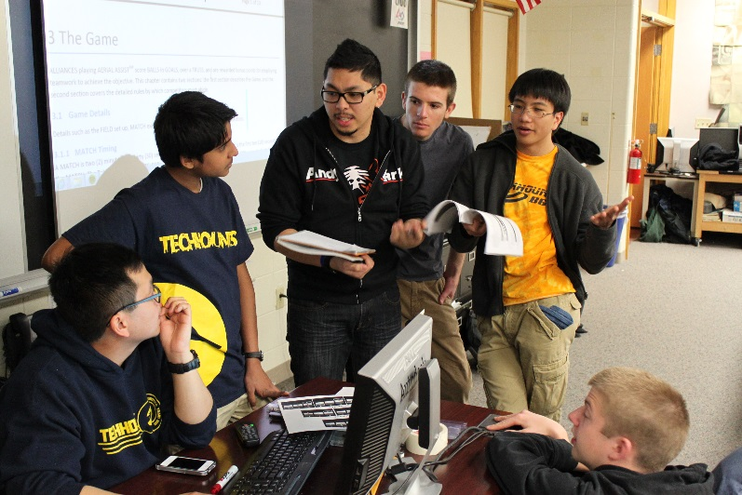
Robot Ops
Brainstorming
CAD
Prototyping
Final Fabrication

Slide 18
Electrical
Leader: Jacob Swiezy

Slide 19
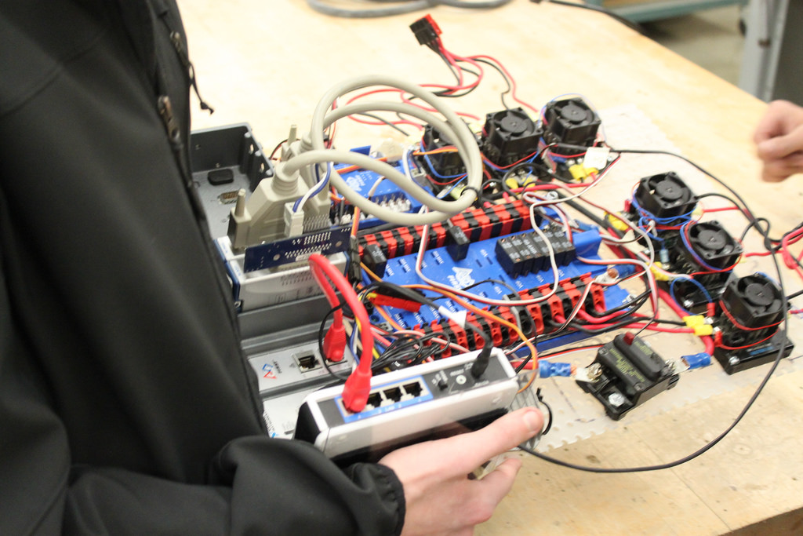
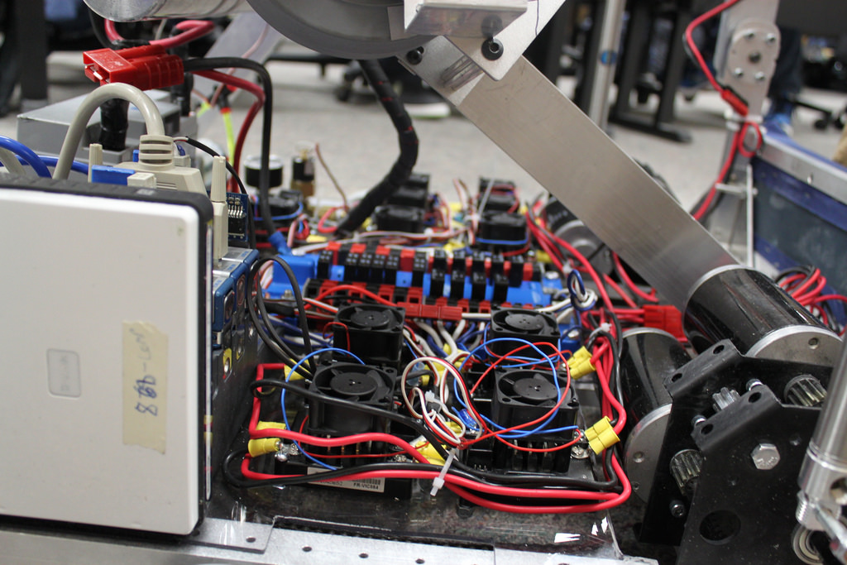
Electrical

Slide 20
Programming
Leader: Evan Dexter

Slide 21
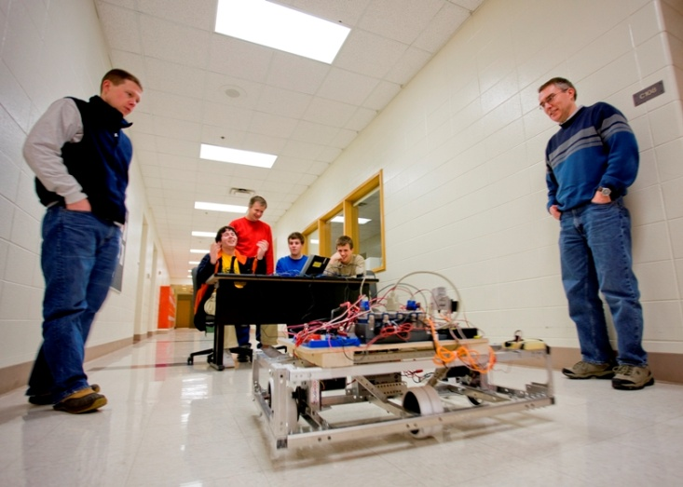
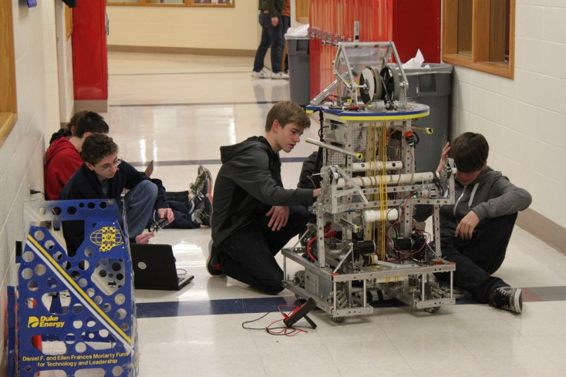
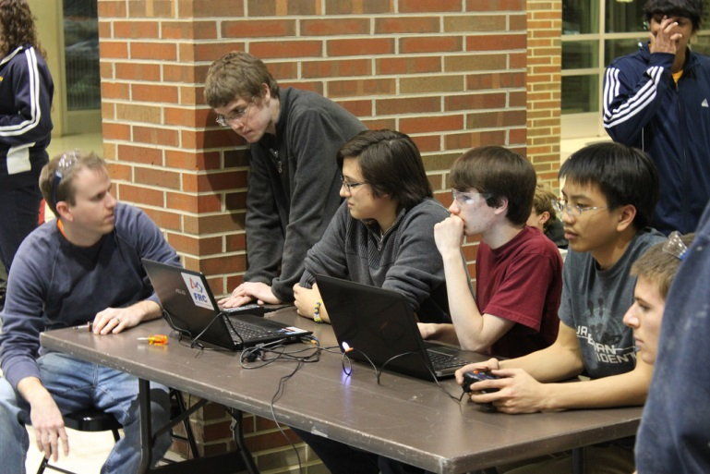
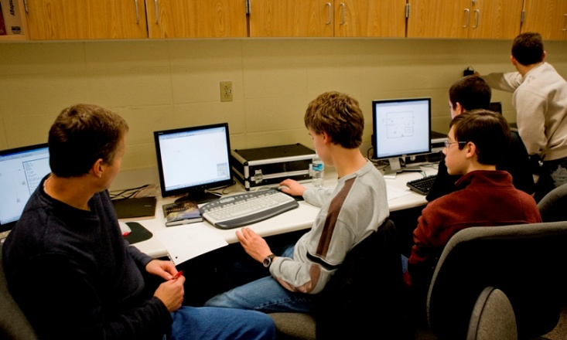
Programming
Learn the basics of Java, a widely used programming language. Write code for the robot.

Slide 22
Construction
Leader: Zach Fleckenstein

Slide 23
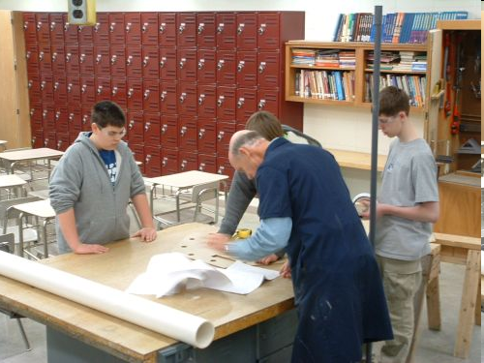
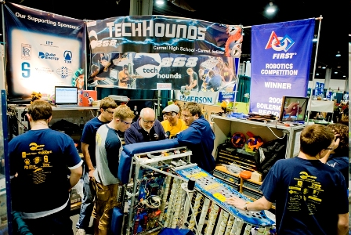
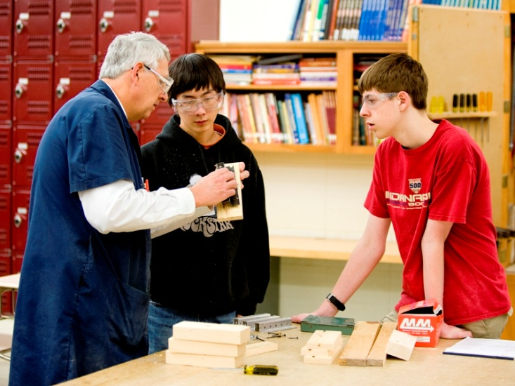
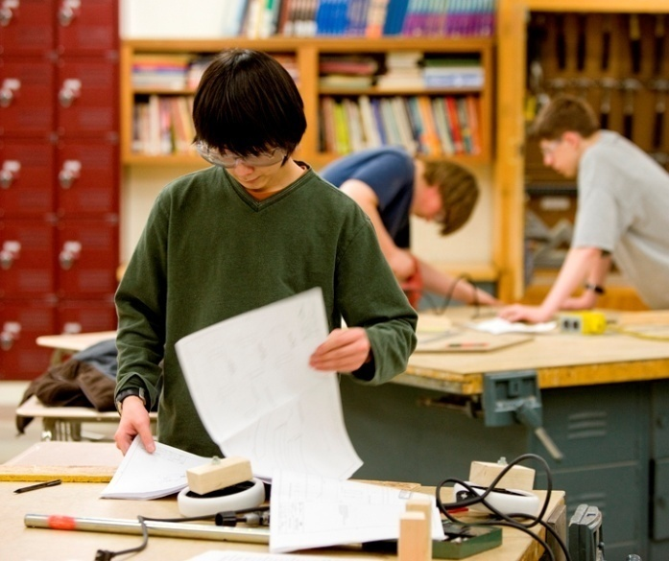
Construction
Work with different materials and operate machine and power tools. Design, create, and assemble a pit area for competitions.
Construct a mock playing field.
Make other components needed for the team.

Slide 24
Information Technology
Leader: Vincent Mai

Slide 25

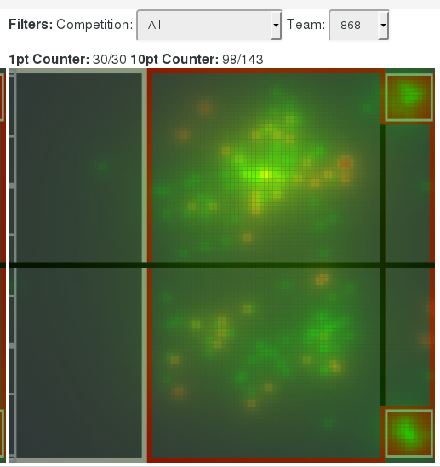
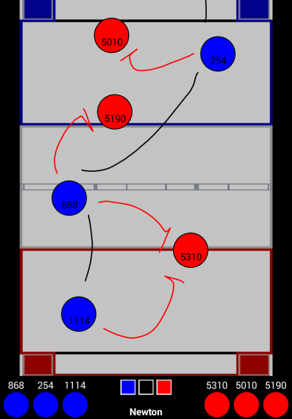
Information Technology
Non-robot programming.
Write tools for use within the team.
Design and build the website.
Learn basic HTML, Javascript, & other programming languages

Slide 26
Public Relations
Leader: Mara Fattah
Notes:
26

Slide 27


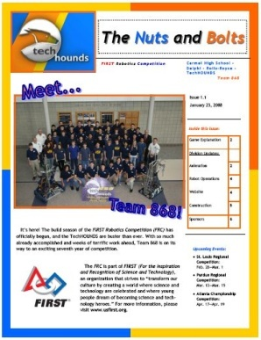
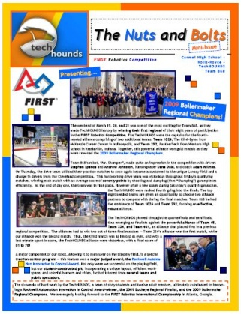

Public Relations

Slide 28
Summary
Student led, mentor guided
Anybody can be varsity

Slide 29
Time Commitment
See our season calendar on www.techhounds.com!
Pre-Season:
Meetings every Thursday 3:30 PM – 5:00 PM
(Required unless excused)
Build Season: Monday, Wednesday, Friday 6:00 PM – 9:00 PM
Dinner Served
Tuesday, Thursday 3:30 PM – 6:30 PM
Occasional Weekend Meetings
Competitions: Two District, One District Championship, One World Championship

Slide 30
Preseason Activities
Meetings: Generally Every Thursday
Divisions: Tool Training, Tutorials, Teaching, and Mock Activities
Latenighter:
A Friday TBD in November
Team Building Activity
Notes:
30

Slide 31
Team Requirements
Must maintain a C or better
in every class and
70% attendance
in order to remain on the team!

Slide 32
Travel Requirements
Must maintain a C or better
in every class and
80% attendance
in order to travel!

Slide 33
Fundraising Requirement
Pre-Season:
$150 by December 4
Build/Competition Season: First District Costs TBD
Second District
District Championship
St. Louis Championship Costs around $500
This is fundraising – raised by talking to corporate sponsors. We’ll help you do it!

Slide 34
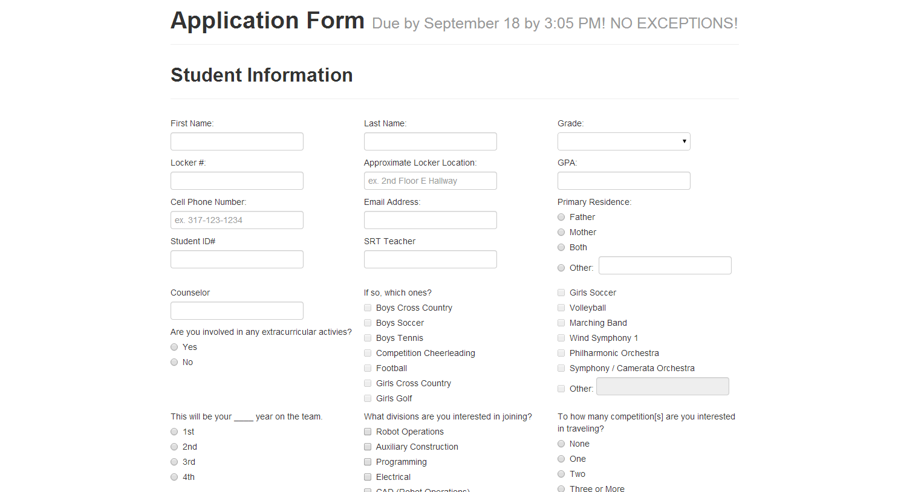
Application
www.techhounds.com/application

Slide 35
Next Meeting
Date: Thursday, September 11
Time: 3:30 – 5:00
Where: C109
TechHOUNDS application is
DUE September 18th NO EXCEPTIONS!

Slide 36
Contact Information
Visit our website: www.techhounds.com
Teacher Contact Info:
ET Education Department Head – Mr. John Coghlan – jcoghlan@ccs.k12.in.us
Mrs. Laura Erli - lerli@ccs.k12.in.us
Mentor Contact Info:
Mr. Carlo Nepomuceno – jcnep@indy.rr.com, carlo.nepomuceno@st.com
Mr. Alex Ryker – aryker@purdue.edu
Student Leads:
Team Lead/Management
Zack Simpson - zacksimpson868@gmail.com
Jackson Otto – jackson868otto@gmail.com
Robot Ops – Aryaman Gupta – arygupta123@gmail.com
Construction – Zach Fleckenstein - zachfleck42@gmail.com
Programming – Evan Dexter – evanjdexter@gmail.com
Electrical – Jacob Swiezy – jeswiezy@gmail.com
IT – Vincent Mai – tqm397@gmail.com
PR – Mara Fattah – marafattah@gmail.com

